Slide 1
NETP interviews – Capital, Coast and Hutt Valley
September 2025 NETP intake

Slide 2
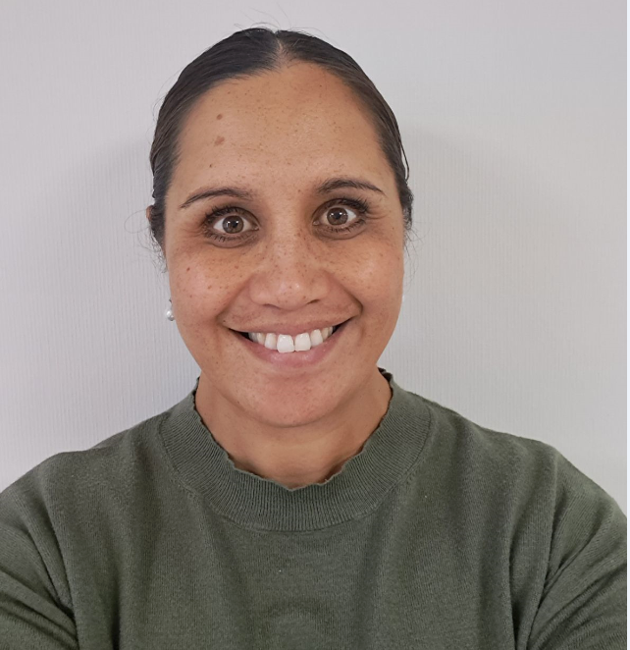
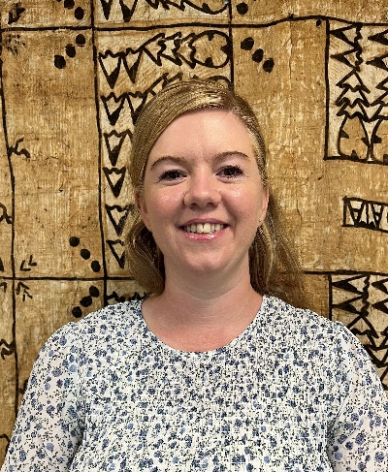
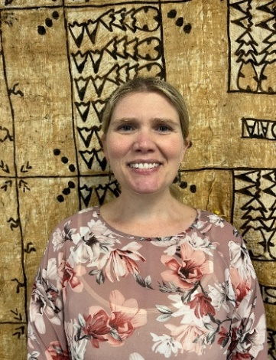
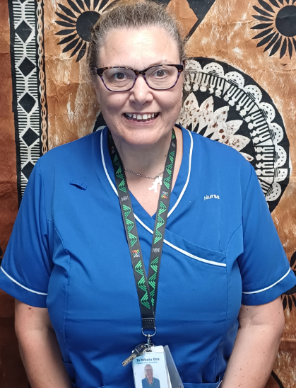
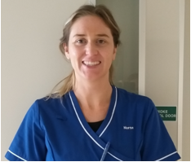
The NETP team
Lisa Karaka
CCHV NETP Coordinator and Cultural Support
Sarah Steele
CC NETP coordinator
To be confirmed
HV NETP Coordinator
Shelley van der Krogt
CCHV NETP Educator
Chrissy Frost
CC NETP
Clinical Coach
Bea Wrenn
CCHV NETP
Clinical Coach

Slide 3
CCHV NETP programme
Most positions are 0.8 FTE
Permanent / Fixed term contracts
NETP study days
Cultural support for Maori and Pacific NETPs
Contracts in Primary and Aged Care may have different FTE
Completion of mid-year performance review
Minimum 96 hours of professional development
Minimum 10 months practice at 0.8FTE
Completion of Competent portfolio

Slide 4
NETP Interviews
Please read the invitation to interview carefully
The venue day and time of your interview
Role description
Please bring the following information with you:
Completed Police vetting form
Copies and originals of two forms of ID
The interview process consists of:
An interview and scenario
Please do not discuss the scenario or the interview with your peers

Slide 5
If successful – Congratulations!
Getting on board
Please:
Complete all on-boarding paperwork asap
Complete Occupational Health link
Apply for Annual Practicing Certificate

Slide 6
Options if not successful
Please keep trying!
Employment continues from talent pool
Apply directly to Primary Health Care or Aged Care
Discuss with your manager about the possibility of joining the next NETP intake
Apply for APC once you have secured a RN positon

